Slide 1
EXPLORATORY DATA ANALYSIS
Pooja Krishnamurthy
DA & DS
May Batch

Slide 2
AGENDA
Introduction
Data understanding
Data Cleaning
Eda and data visualization
Feature Engineering
Insights
Conclusion

Slide 3
Introduction
The project involves analysis of a housing dataset.
The dataset contains detailed information about residential properties.
Key features include:
Price
Property size (e.g., square footage)
Location (city, zip code, country)
Condition (quality and maintenance)
The goal is to understand the factors influencing housing prices.
Analysis results will help real estate stakeholders make informed decisions

Slide 4
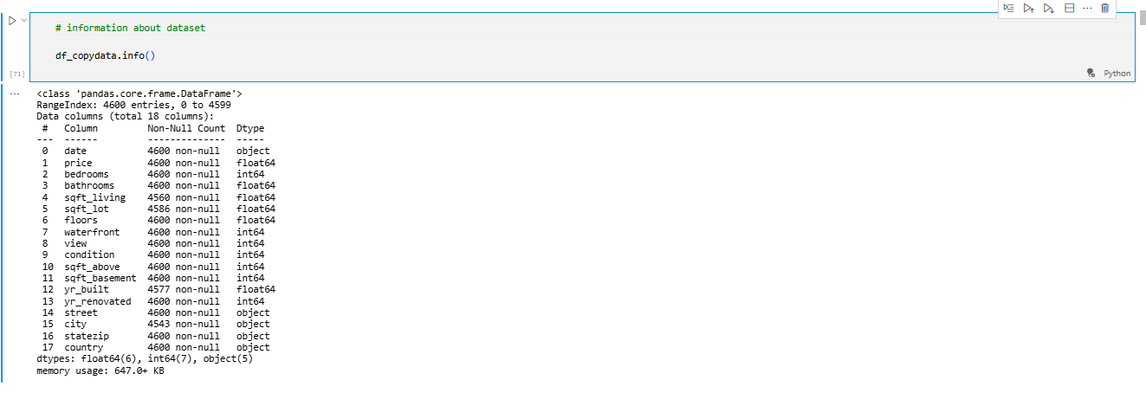
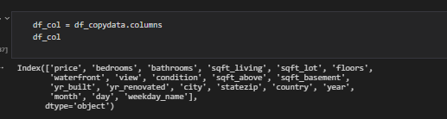
Data Understanding
Dataset : Housing dataset in the format of csv file
Key columns : Price , sqft_living , Bedrooms , Bathroooms , yr_built,etc..
Data types: Numerical,Categorical and datetime
It has 4600 Rows and 18 columns

Slide 5
Data cleaning
✅ Handled Missing Values
Identified missing entries in key columns
Filled or removed missing values using appropriate methods (e.g., mean, mode, or deletion)
✅ Fixed Inconsistent Data
Corrected irregular entries (e.g., formatting issues, incorrect data types)
Standardized values for consistency
✅ Removed Duplicates
Checked and dropped duplicate rows to avoid redundancy
✅ Data Type Conversion
Converted date strings to datetime format
Ensured numerical features had the correct data types (e.g., float, int)

Slide 6
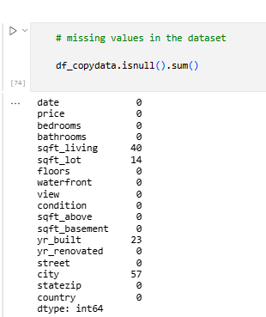
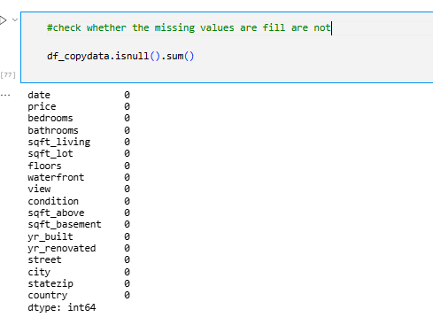
Missing values
Isnull().sum() - Used to identified the null values present or not
Numerical : Filled with median/mean
Categorical : Filled with mode

Slide 7
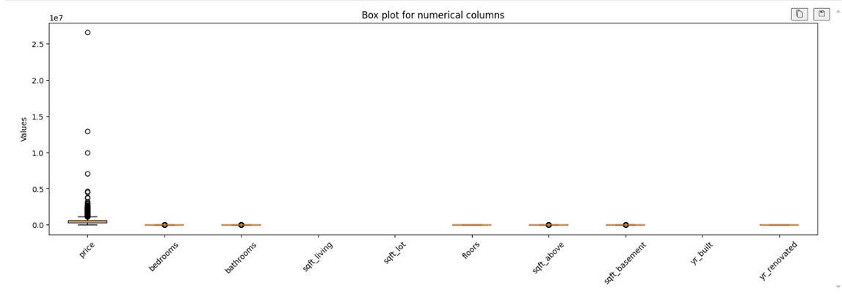
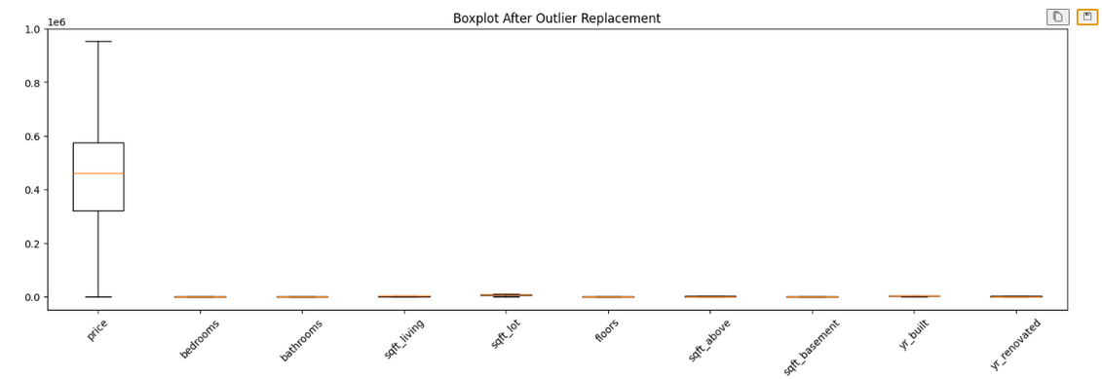
Outlier Handling
IQR = Q3 − Q1 (spread of middle 50%)
Lower Bound = Q1 − 1.5 × IQR
Upper Bound = Q3 + 1.5 × IQR
Values outside this range are outliers
Checked Columns:
Price, Sqft_living, Sqft_lot, Bedrooms, Bathrooms
Action:
Removed extreme outliers
Verified with boxplots

Slide 8
Statistical Analysis
✅ Descriptive Statistics
Computed mean, median, mode, and standard deviation
Summarized features like price, bedrooms, bathrooms, and sqft_living
✅ Hypothesis Testing
Two-sample t-test: Compared mean prices across different view categories
One-way ANOVA: Tested price differences among multiple view groups
Chi-square Test: Checked dependency between view and condition

Slide 9
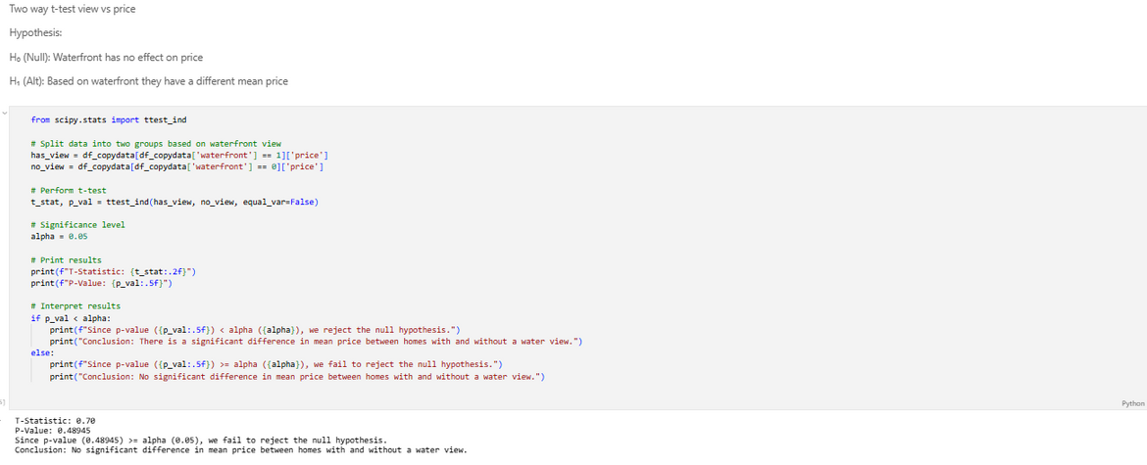
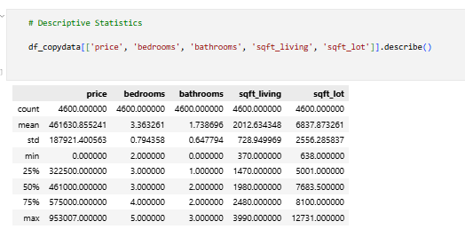
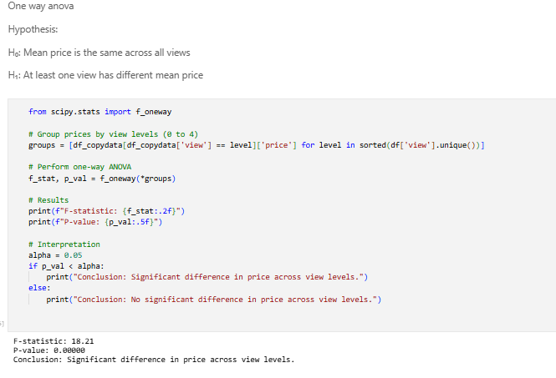
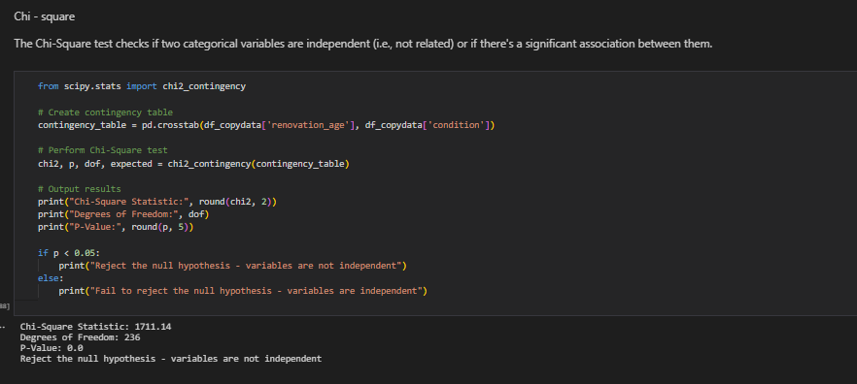
Two way t-test
Descriptive statistics
One way anova
Chi - square test

Slide 10
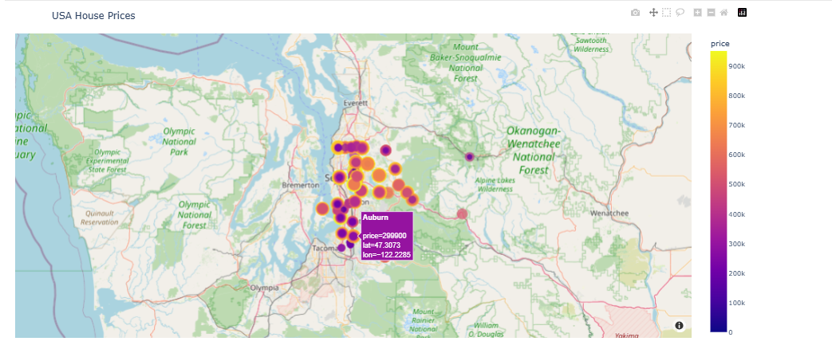
Data visualization
Histograms & box plots for distributions and outliers
Scatter plots to show relationships (e.g., price vs. sqft)
Bar charts for categorical comparisons (e.g., view, condition)
Maps to visualize price by location
Heatmaps for feature correlations

Slide 11
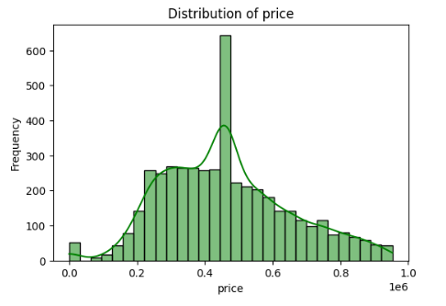
Univariate analysis
Univariate Analysis
Examines single variables
Uses summary stats & visualizations (histograms, box plots)
Example: Distribution of house prices

Slide 12
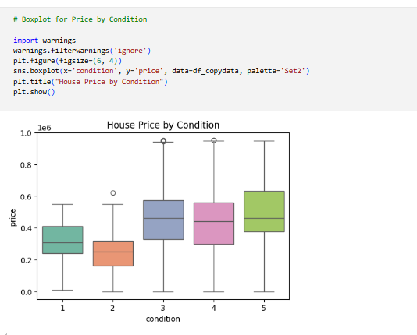
Bivariate analysis
Bivariate Analysis
Studies relationship between two variables
Uses scatter plots, bar charts, and correlation tests
Example: Price vs. sqft_living

Slide 13
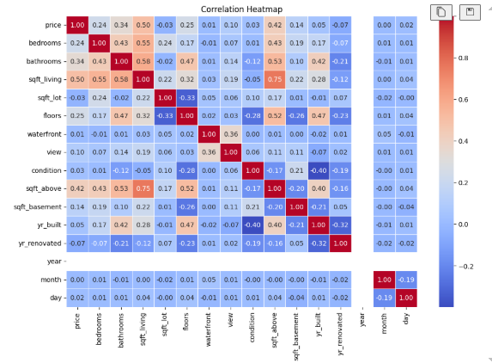
Multivariate analysis
Multivariate Analysis
Explores interactions among multiple variables
Uses correlation matrix, heatmaps, and regression models
Example: How price depends on bedrooms, bathrooms, and location

Slide 14
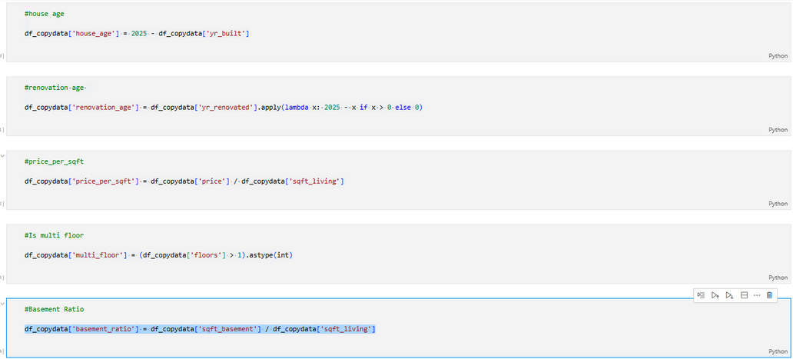
Feature Engineering
Creating new variables from existing data to improve analysis and modeling.
Created House Age = Current Year − Year Built
Calculated Renovation Age = Current Year − Year Renovated (if renovated)
Derived Price per Sqft = Price ÷ Sqft_living
Identified Multi-floor properties based on floor count
Engineered features to improve model accuracy and insights

Slide 15
Conclusion & Recommendations
Location, size, condition, and view strongly affect housing prices.
Waterfront and good views boost property value.
Proper data cleaning ensured accurate analysis.
Buyers and sellers can use these insights for better decisions.
Recommendations:
Improve property condition to raise value.
Choose homes with good views or waterfronts.
Use price per sqft for comparisons.

Slide 16
Thank you

